Slide 1
Commercial water treatment

Slide 2
COMMERCAL QUIPMENTS FOR WATER TREATMENT
In commercial methods different types filtering models are used for the filtration process. These filtering models are mainly produced by different companies.
The topmost companies which produces the filters are:
KENT
HAVELLS MAX
LIVPURE
BLUE STAR
AQUAGUARD
PUREIT
AO SMITH
WATER DOCTOR- and so many

Slide 3
Various equipment are
UV disinfection
Iron removal filters
Sand filters
Softeners
RO filters (Reverse osmosis ) filters
Sand filter
Activated carbon filter
Demineralization
Simple filter and so many equipment

Slide 4
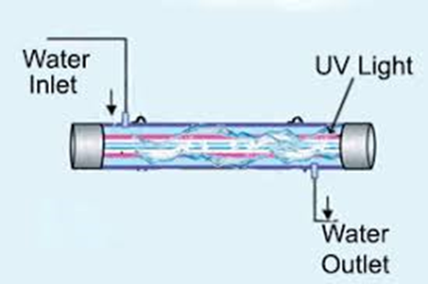
UV filters are a type of water filtration system that use ultraviolet light to purify water. They are commonly used in households, as well as in industrial and commercia settings to remove harmful microorganisms from the water supply.

Slide 5
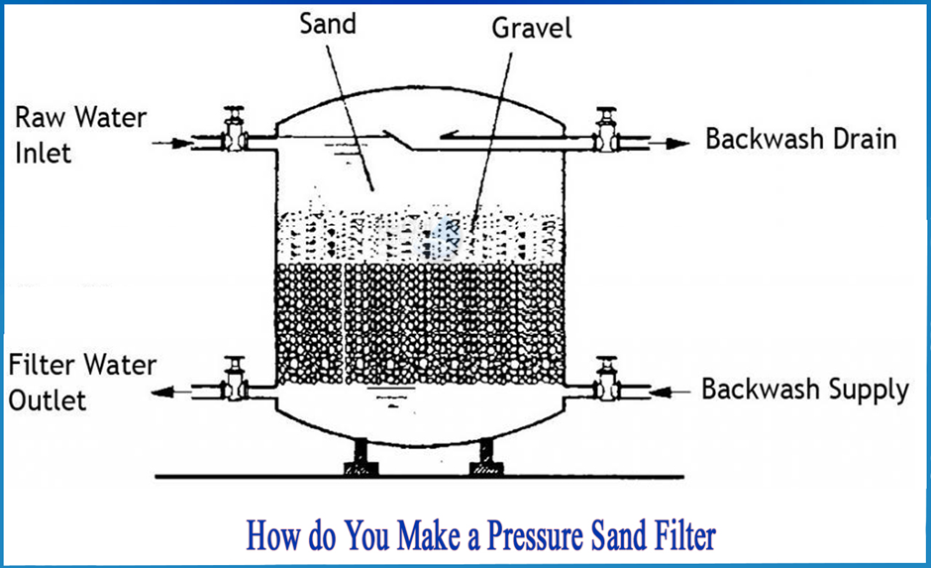
Sand filter

Slide 6
Sand fiter
Rapid sand filter
Slow sand filter
Pressure sand filter

Slide 7
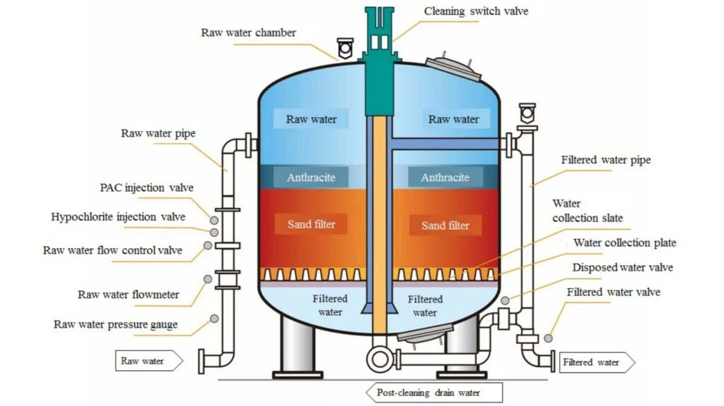

Slide 8
Anthracite
coal of a hard variety that contains relatively pure carbon and burns with little flame and smoke

Slide 9
Activated carbon filter
Activated Carbon Filter (ACF) works on the principle of adsorption, where contaminants are attracted to and stick to the porous surface of the activated carbon material as water passes through.

Slide 10
Activated carbon filter cont.
ജലശുദ്ധീകരണ പ്രക്രിയയിൽ കാർബൺ ഫിൽട്ടറുകൾ നിർണായക പങ്ക് വഹിക്കുന്നു, കാരണം അവ വെള്ളത്തിൽ അടങ്ങിയിരിക്കാവുന്ന അനാവശ്യമായ എല്ലാ രാസവസ്തുക്കളെയും ക്ലോറിൻ, കീടനാശിനികൾ, മറ്റ് വോളറ്റൈൽ ഓർഗാനിക് സംയുക്തങ്ങൾ (VOC-കൾ) പോലുള്ള ജൈവ സംയുക്തങ്ങളെയും നീക്കം ചെയ്യുന്നു.

Slide 11
Activated carbon filter contd
വെള്ളത്തിന്റെ രുചി മെച്ചപ്പെടുത്തുന്നതിനൊപ്പം, ദുർഗന്ധവും ദുർഗന്ധവും നീക്കം ചെയ്യുന്നതിലും ഇവ ഫലപ്രദമാണ്. വെള്ളം ഒരു കാർബൺ ഫിൽട്ടറിലൂടെ കടന്നുപോകുമ്പോൾ, സജീവമാക്കിയ കാർബൺ കണികകൾ ഈ മാലിന്യങ്ങളെല്ലാം ആഗിരണം ചെയ്യുന്നു, അതോടൊപ്പം മോശം രുചിയും ജൈവ സംയുക്തങ്ങളും ആഗിരണം ചെയ്യുന്നു.
RO-യ്ക്ക് മുമ്പും RO-യ്ക്ക് ശേഷവുമുള്ള ശുദ്ധീകരണ ഘട്ടങ്ങളിൽ കാർബൺ ഫിൽട്ടറുകൾ ഉപയോഗിക്കുന്നു. ഓരോന്നിന്റെയും പ്രാധാന്യവും ഗുണങ്ങളും നമുക്ക് മനസ്സിലാക്കാം.

Slide 12
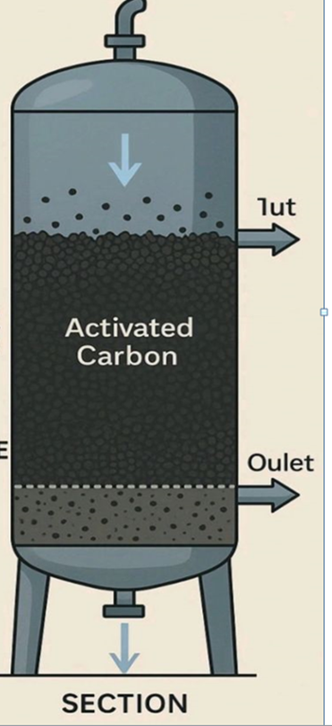
Activated carbon filter

Slide 13
Iron remval medias
1.0 Manganese Dioxide
2.0 catalox
3.0 Purolite
4.0Berm Media
5.0 other suitable medias

Slide 14
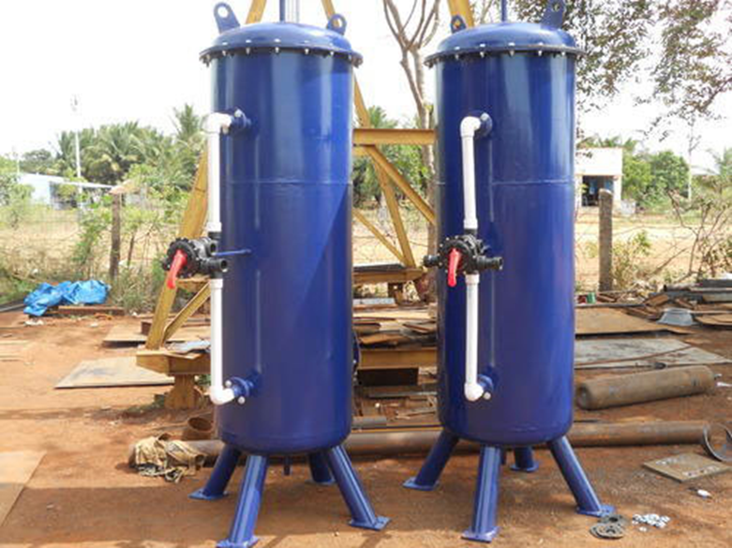

Slide 15
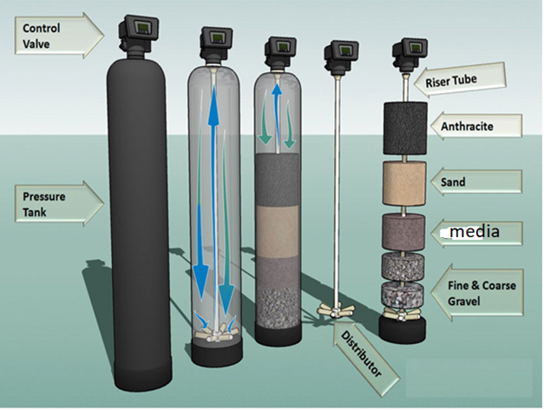

Slide 16
Properties of iron removal media and the process
Increasing the pH
Oxidation of ferrous iron to ferric iron
Fe2 +H2O+O2 gives Fe(OH)3 +H+
Filter to remove sediments
Efficiency for each media differs

Slide 17
Reverse osmosis
Reverse osmosis is a water purification process that uses a semi-permeable membrane to remove contaminants by applying pressure to force water molecules from a high-concentration solution to a low-concentration solution, inverting the natural osmosis process. This method is used for desalination, producing high-quality drinking water, and other industrial applications

Slide 18
Reverse osmosis
Reverse osmosis (RO) is a water purification process that uses a semi-permeable membrane to separate water molecules from other substances.

Slide 19
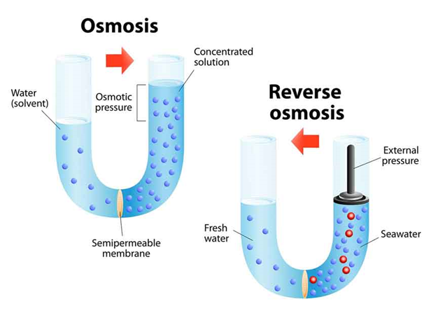
Reverse Osmosis

Slide 20
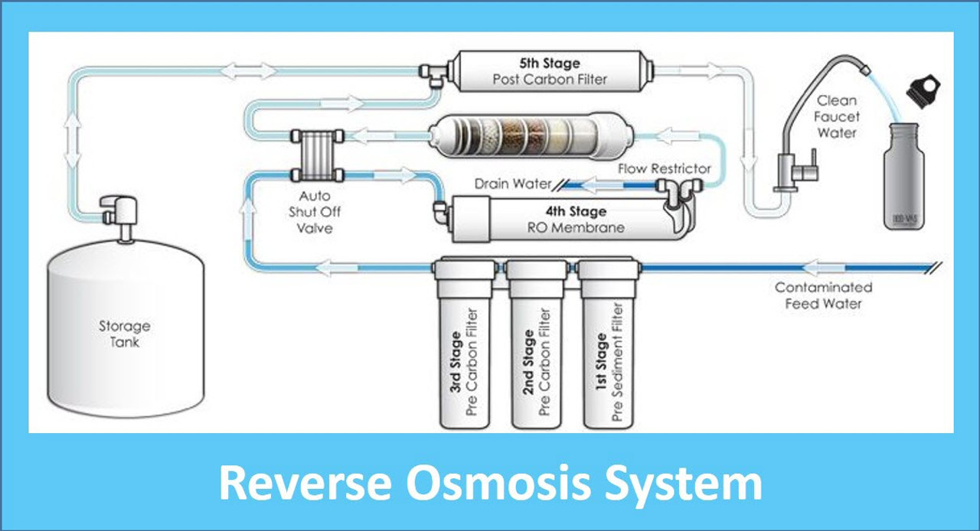
RO filter

Slide 21
Major demerits of reverse osmosis
. The main disadvantages include
Significant water wastage,
The removal of beneficial minerals,
Ongoing maintenance costs.

Slide 22
Hardness removal
Ion exchange removes water hardness by replacing hardness-causing ions, like calcium and magnesium, with other ions, typically sodium, as water passes through a resin bed.

Slide 23
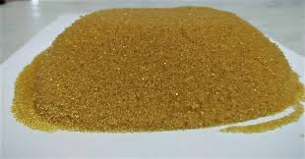
Hardness removing resins

Slide 24
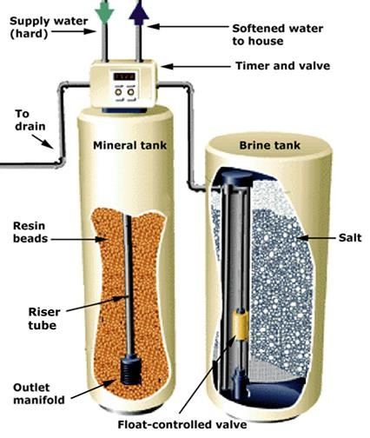
HARNESS REMOVAL

Slide 25

Chemical reaction

Slide 26
ReGeneration of the resin
This is achieved by treating the spent resin with a chemical regenerate solution, such as a strong acid for cation resins (e.g., HCl) and a strong base for anion resins (e.g., NaOH). After the regeneration, the resin is typically rinsed thoroughly and can be reused for many cycles

Slide 27
Simple filters
Activated carbon, sand filter

Slide 28
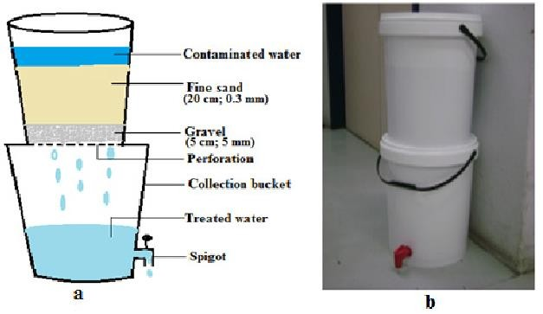
Filter

Slide 29
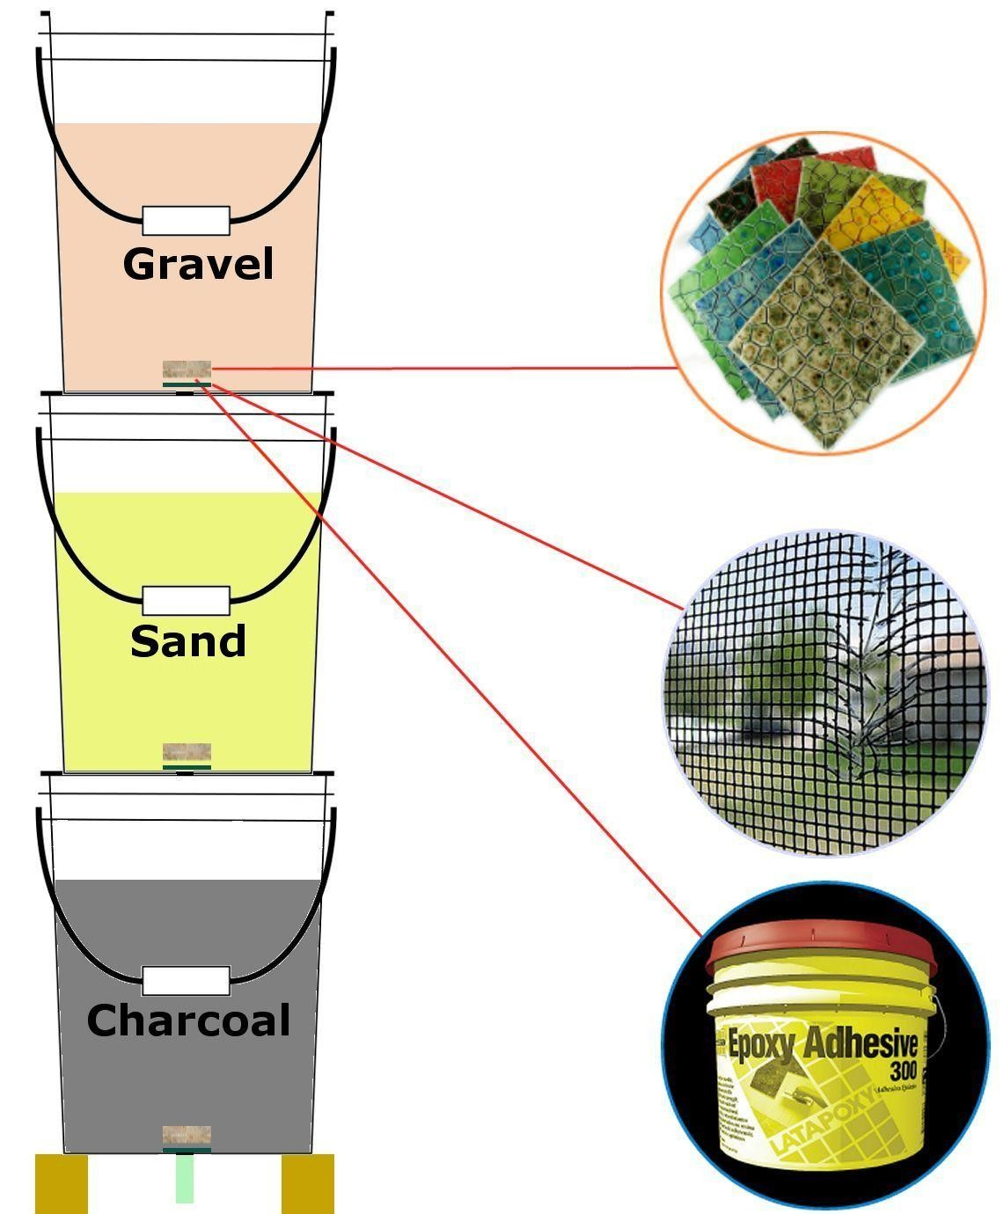

Slide 30
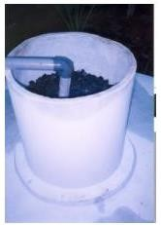
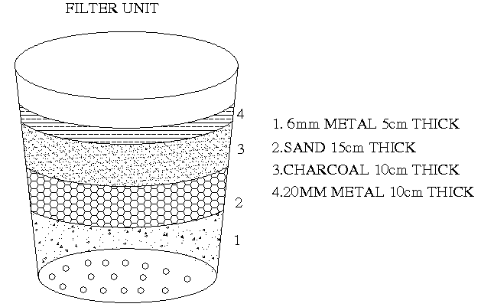
Filter

Slide 31
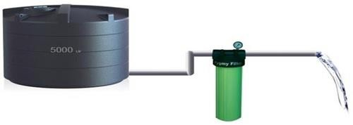
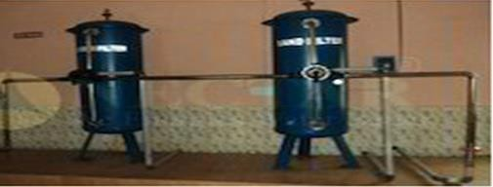
COMMERCIAL EQUIPMENT FOR WATER QUALITY
ISSUES
Different types of equipments are available in the market
Some of these are given below
Pygmy Filter Pr. Sand Filter
50

Slide 32
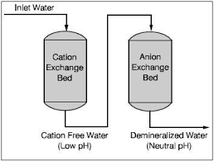
Hardness removal

